Slide 1

Web scraping to gain company insights
14/01/2023

Slide 2
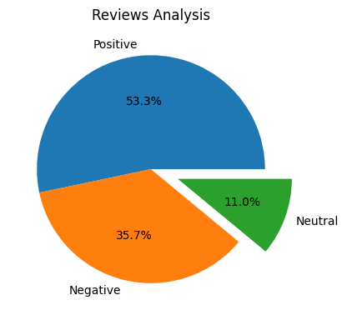
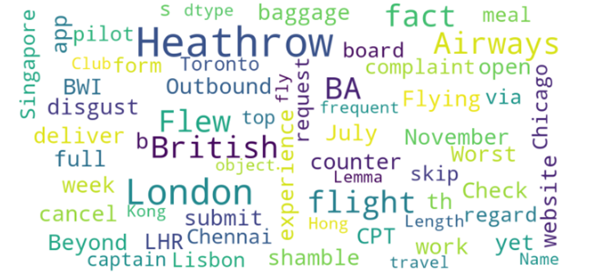
INSIGHTS FROM CUSTOMER REVIEWS
From cleaning 1000 reviews given by the customers, we obtained
Positive Reviews - 533
Negative Reviews - 357
Neutral Reviews – 110
Word cloud of keywords used in reviews

